Slide 1
HCI Final Project
Team 2: Gavin Earley, Jacob LaFazia, Fariz Sutansyah

Slide 2
Preschool Kids app
Problems/Goals
If an image says a thousand words, then how to you pick the right image?
What makes an interface visually appealing to young kids?
How to best describe an action with a picture.
What colors are most exciting to kids?

Slide 3
Why is this needed?
Help kids learn the basics earlier
Simple descriptive interface is needed for kids who cannot yet read
Make learning fun so they will love to learn

Slide 4
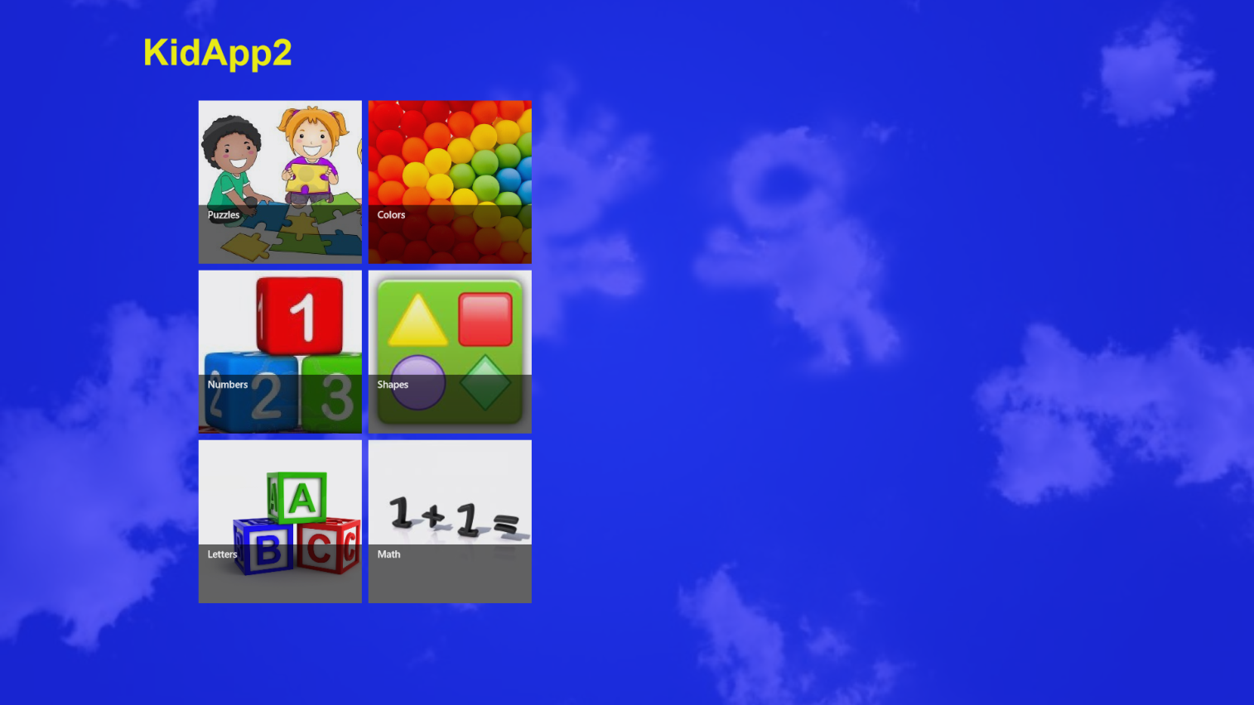
The Starting Page

Slide 5
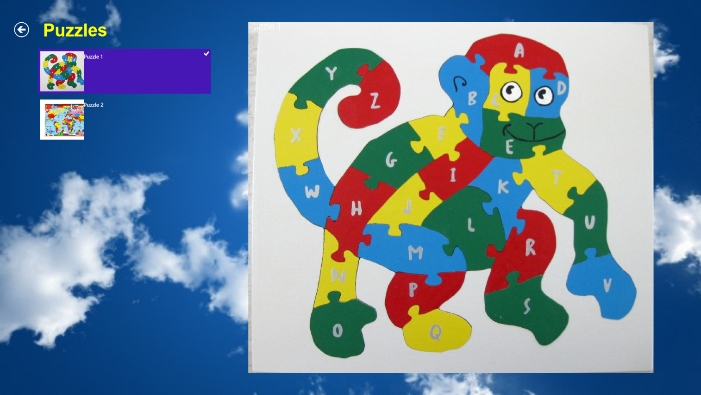
Puzzles

Slide 6
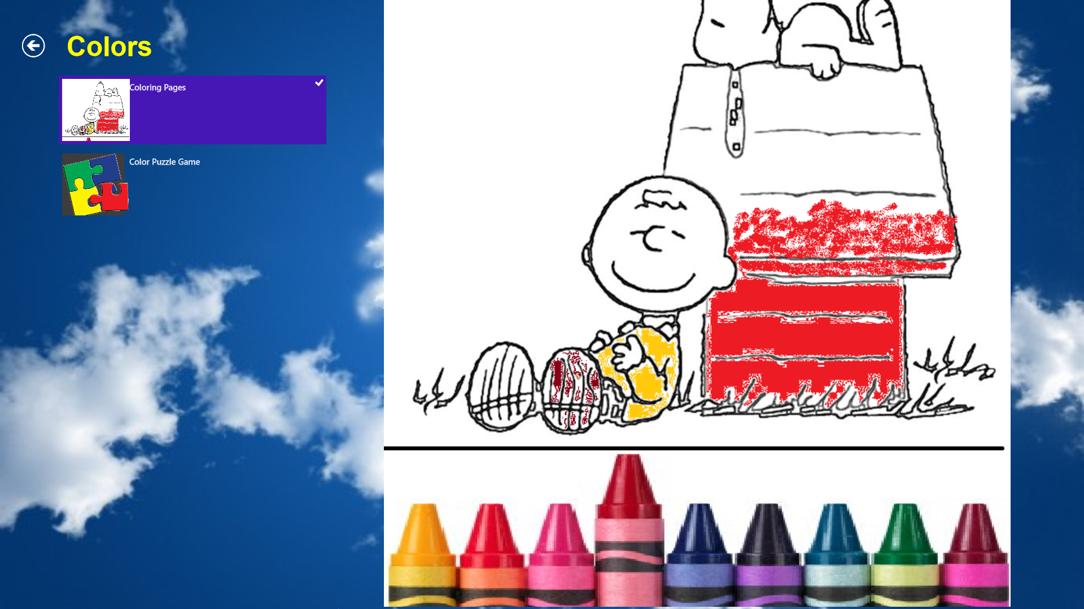
Colors

Slide 7
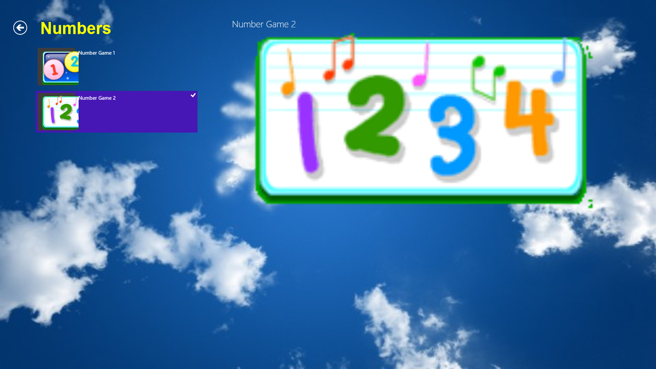
Numbers

Slide 8
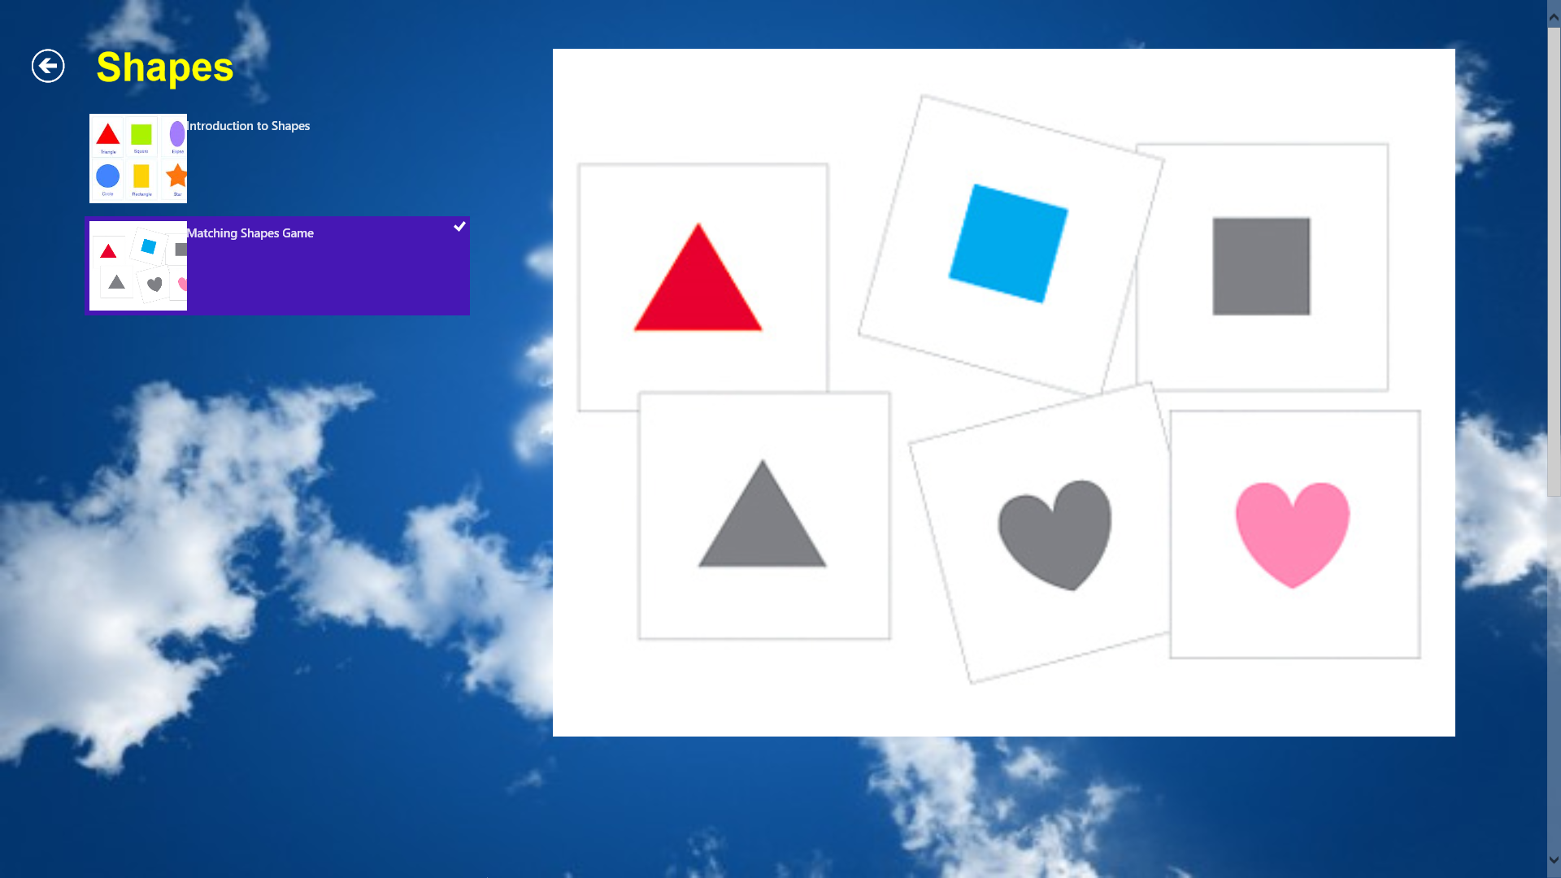
Shapes

Slide 9
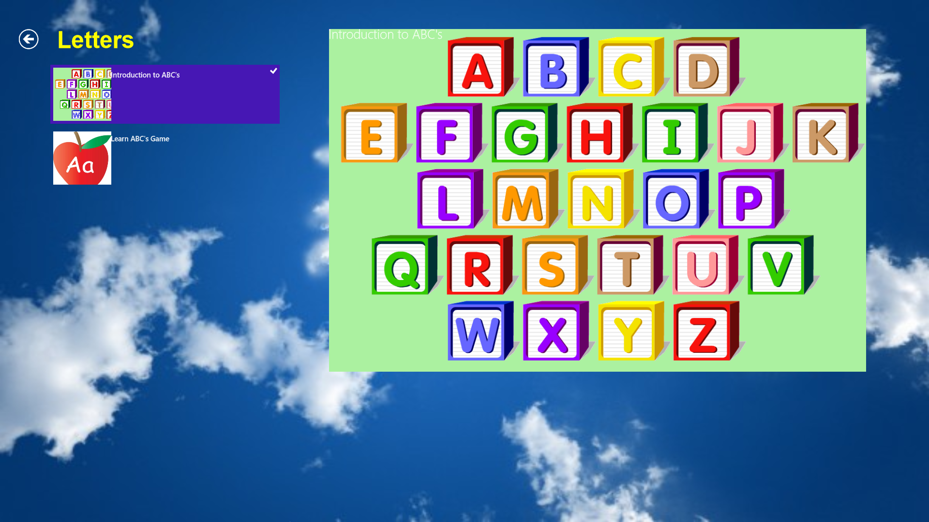
Letters

Slide 10
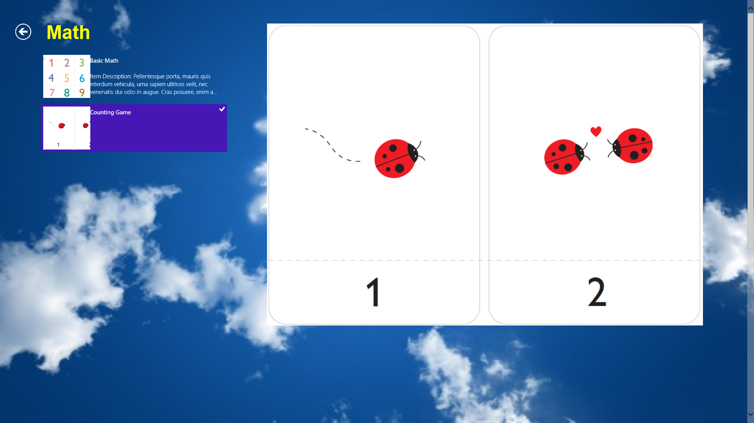
Math

Slide 11
Review/Revision Before

Slide 12
Review/Revision After

Slide 13
Design Successes
Tested with 2 preschool aged children
Simple pictures made interface easy to use

Slide 14
Questions?

